Slide 1

Business Analysis
Crypto & Stock 2023 Potential
Performance, Risk, Sentiment
Damian Neya Zach

Slide 2

Our motivations
Our motivation began with trying to figure out how certain age groups invest their money & how can we predict what their portfolio’s would look like. As we went through and began searching for data, we found that there was a lot more to this question than we initially thought.

Slide 3

Questions we asked ourselves
Once we asked ourselves how do these demographics invest and struggling to find any solid leads, we began to think of how can we assess how these different age groups invest. How far does our data set need to be to obtain an accurate analysis? What assets would be valuable in assessing our data? What should our approach to these data sets be? We concluded that if we create tools that can find the performance, risk, and sentiment of different assets we can better analyze what these age groups would likely want to invest in.

Slide 4
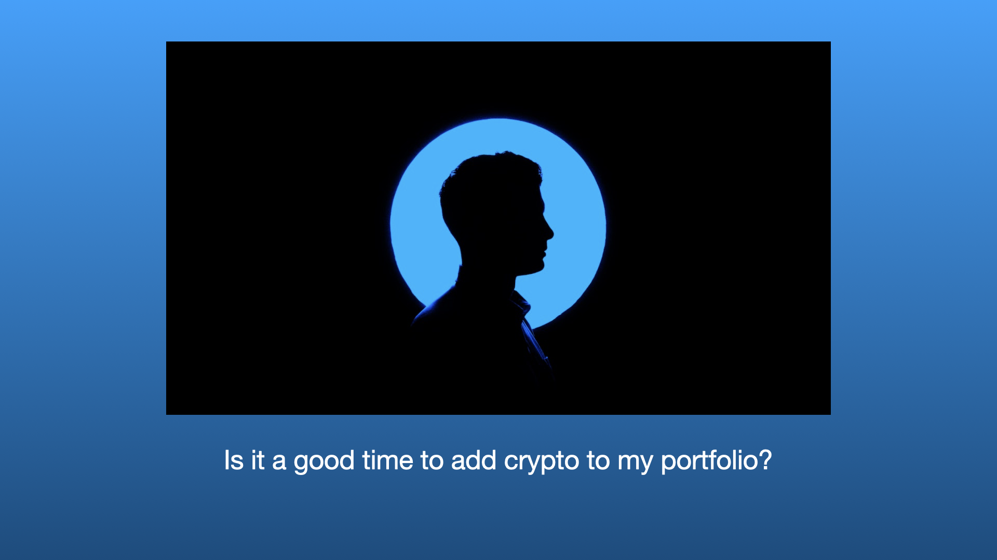

Slide 5
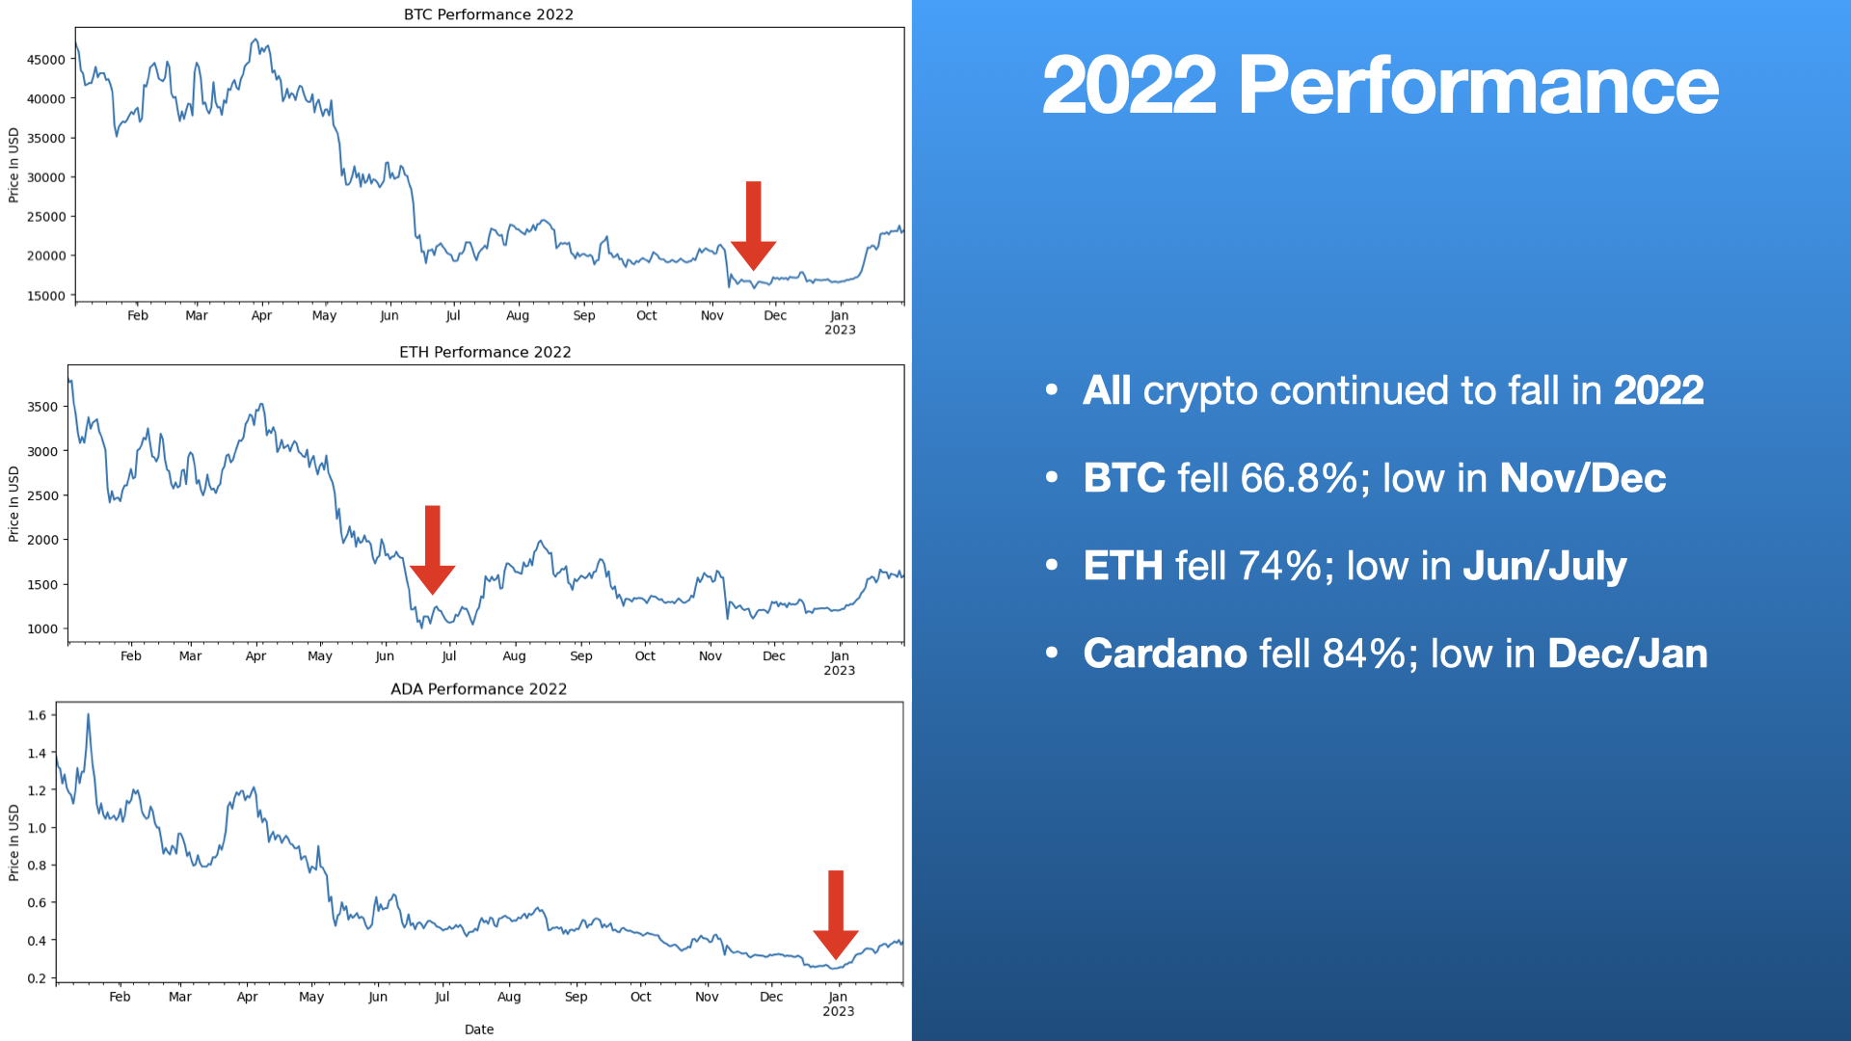

Slide 6
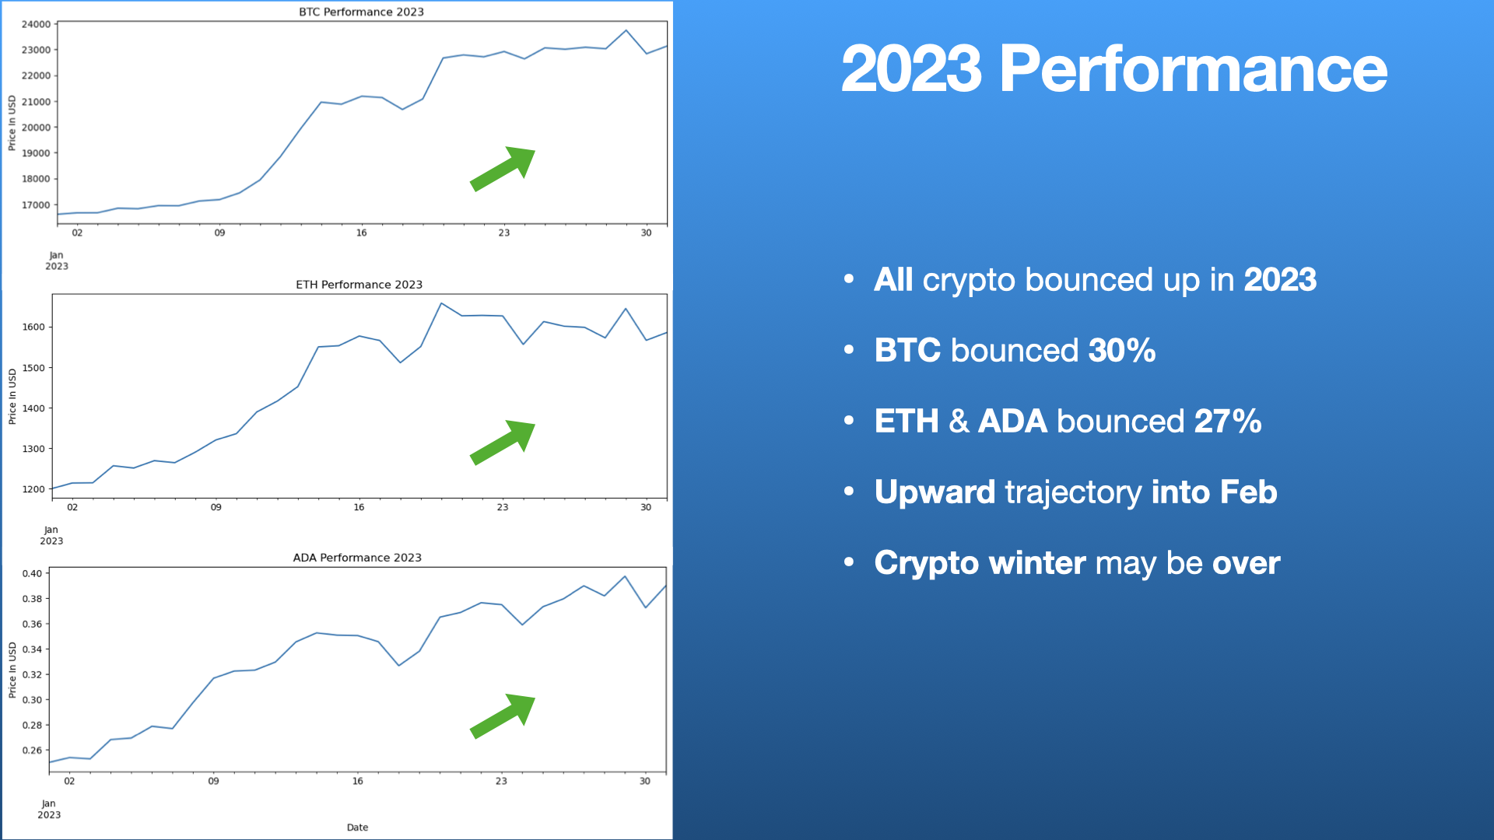

Slide 7
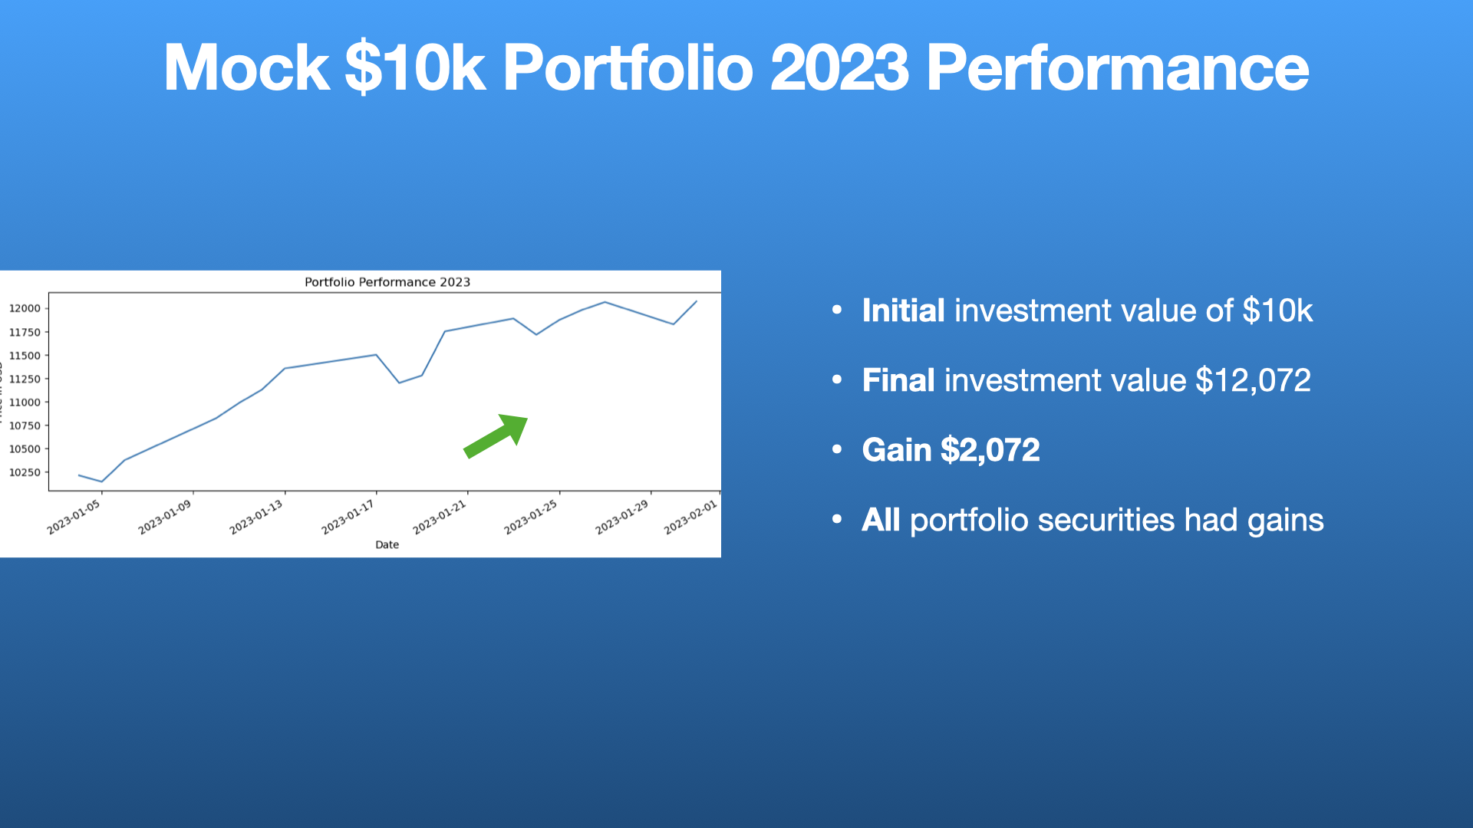

Slide 8

Stock & Crypto Risk Analysis

Slide 9
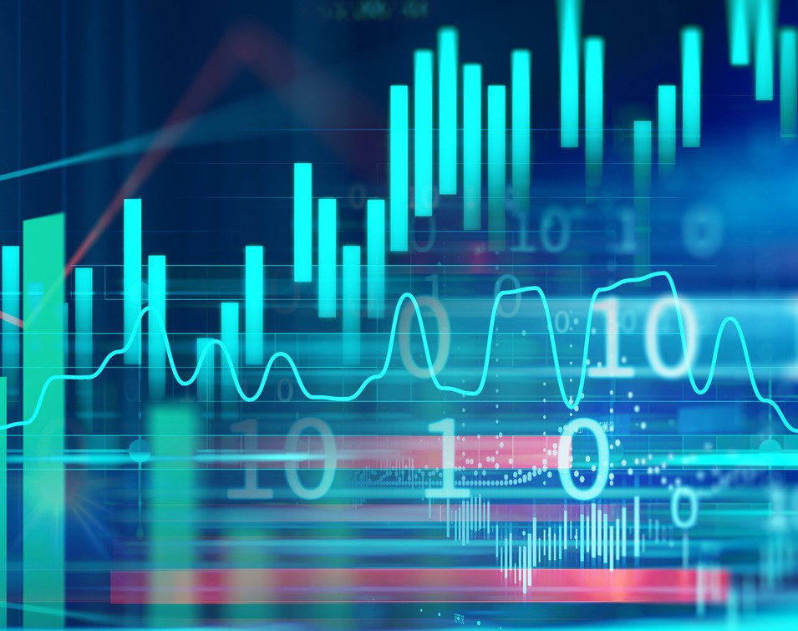
What is risk?
Risk is the probability of an assets likelihood to gain or lose value based on market volatility.

Slide 10
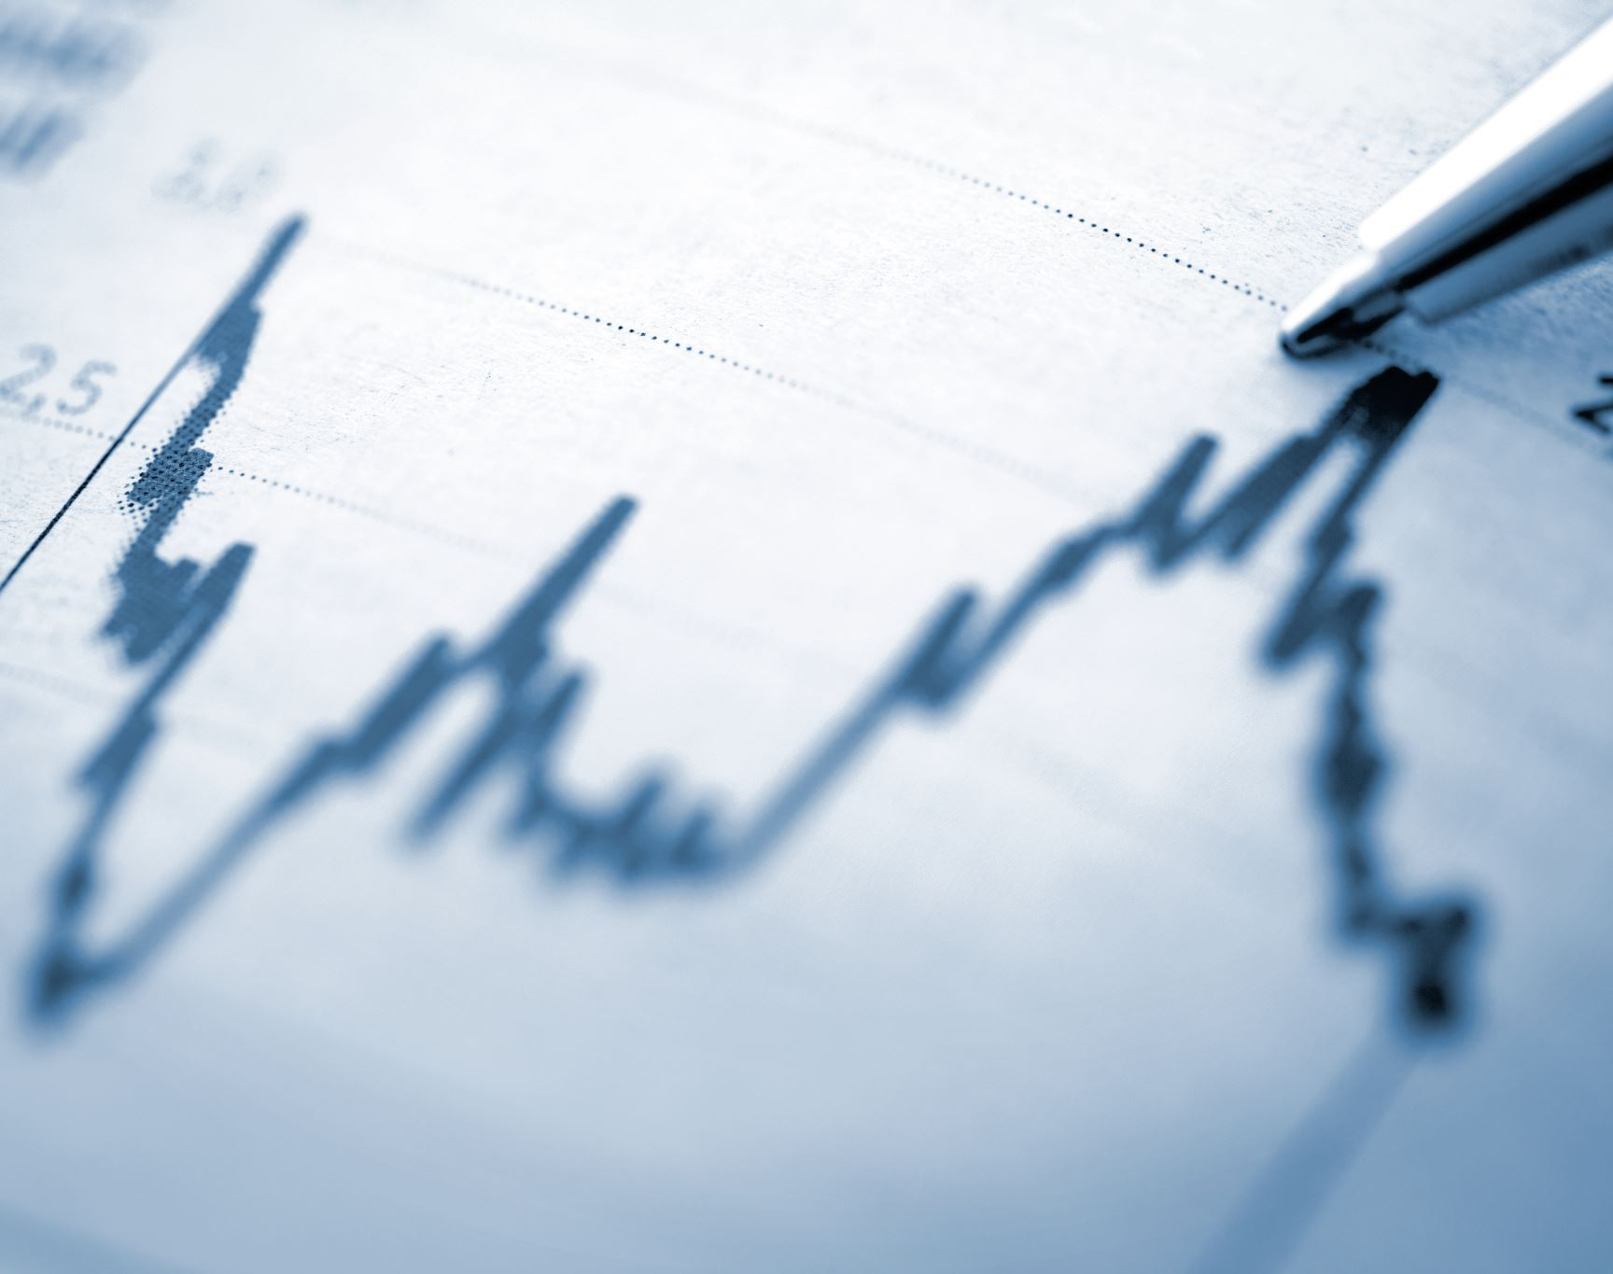
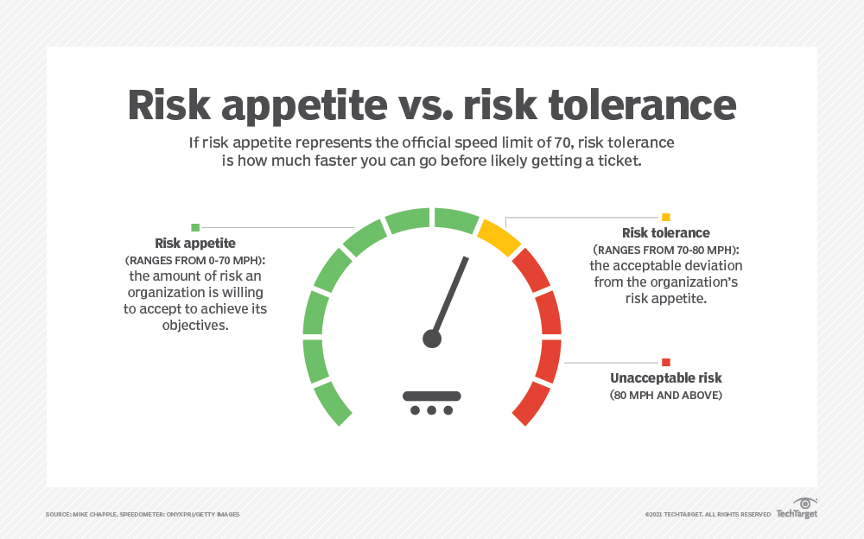
Why is understanding risk important to your portfolio?
Understanding the potential risk of the assets in your portfolio will help you make a more informed decision with how you want to invest.

Slide 11

Crypto & Stock Sentiment

Slide 12
Before analysis
Risk Profile Ticker
Risk Profile Ticker
Minimal Risk
Maximum
Maximum Risk
Maximum Risk
Maximum Risk
Maximum Risk
Minimal Risk stocks have favorable sentiment.
Maximum Risk stocks/ETFs will have negative/less favorable sentiment.

Slide 13
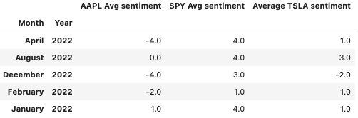
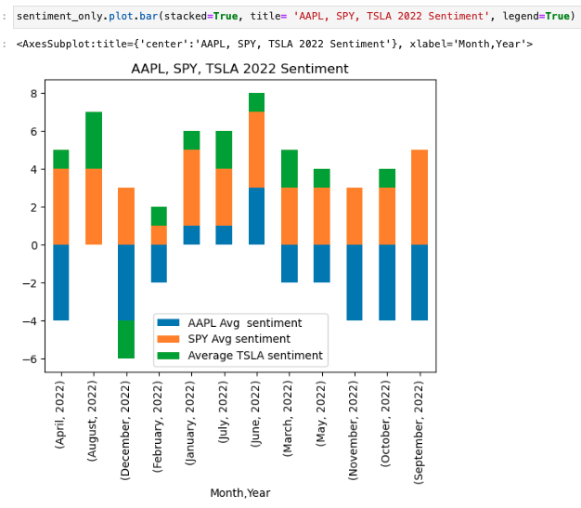
Stock Sentiment
AAPL total avg sentiment = -2
SPY total avg sentiment = 3
TSLA total avg sentiment = 0

Slide 14
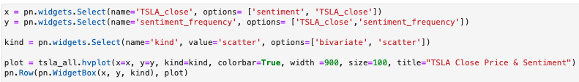
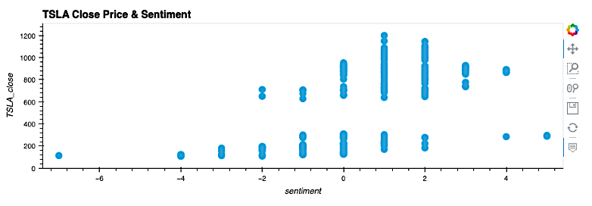
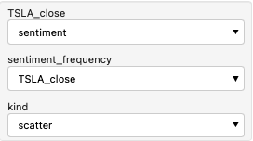
TSLA
The highest sentiment was during TSLA
stock split.
Lowest sentiment – Jan 2023.

Slide 15
Risk & Sentiment
Findings After Analysis:
Sentiment Analysis can be used as a technical trigger to invest or purchase options contracts.
Minimal Risk stocks have less favorable market sentiment.
Maximum Risk stocks have high sentiment.
Risk Profile Ticker
Minimal Risk AAPL
Maximum ADA
Maximum Risk BTC
Maximum Risk ETH
Maximum Risk SPY
Maximum Risk TSLA

Slide 16

What we found after researching
Creating tools that could be used to better to evaluate assets was a much more effective method to articulate why and where specific demographics should invest in, rather than simply “how” they invest in themselves.

Slide 17

Summary
We begin by analyzing the historical performance data from 2022 into 2023, using an various sources. Following this, we simulate a portfolio investing $10k at the beginning of the year to verify performance. After we have a sense of market performance, the portfolio is assigned a risk profile that can be checked against our client's risk tolerance. Finally, we analyze current market sentiment and gauge the confidence levels of traders and investors for the crypto and stock markets.

Slide 18

Sources
Kaggle: https://www.kaggle.com/
Historic_Crypto API: https://pypi.org/project/Historic-Crypto/
Pandas: https://pandas.pydata.org/docs/
Relative Risk theory: Link
Investopedia: https://www.investopedia.com/terms/r/risk-analysis.asp
https://codelabs.developers.google.com/codelabs/cloud-natural-language-python3#7
Gcloud Google Cloud: https://console.cloud.google.com/apis/library?project=sentimentandrisk&cloudshell=true
Sentiment data – RTAT nasdaq reports. https://docs.data.nasdaq.com
Plots: https://hvplot.holoviz.org/user_guide/Timeseries_Data.html
News: https://alpaca.markets/docs/market-data/news/

